Slide 1
Azure DocumentDB
Your Cloud-powered, Geo-scaled, NoSQL Superweapon… Hiding in Plain Sight
Josh Lane
Principal Architect @ Wintellect
@jplane

Slide 2

Azure DocumentDB
Blazing fast, planet scale NoSQL service
Guaranteed low latency
Elastic limitless scale
Globally replicated
Schema freedom
<10ms Reads
<15ms Writes
Millions of RPS
Many TBs of data
Transparent Partitioning
Low-latency access around the globe!
Automatic Indexing
Easy-to-learn query grammar
Multi-Record Transactions
99.99% SLAs for availability, latency, and throughput
Notes:
Azure DocumentDB is
- a global scale NoSQL data store that has very fast read and write performance
virtually limitless scale
one-click geo-redundancy and replication
a 4 9s SLA
DocDB was envisioned from the outset to combine the modern, developer-friendly capabilities of NoSQL databases like MongoDB and Cassandra with the power, scale, and ease-of-use of a cloud-native and geo-distributed PaaS product. It works with any modern technology stack using either native SDKs or REST API calls and supports common database features like stored procedures, triggers, change tracking, and a SQL-based query syntax.

Slide 3
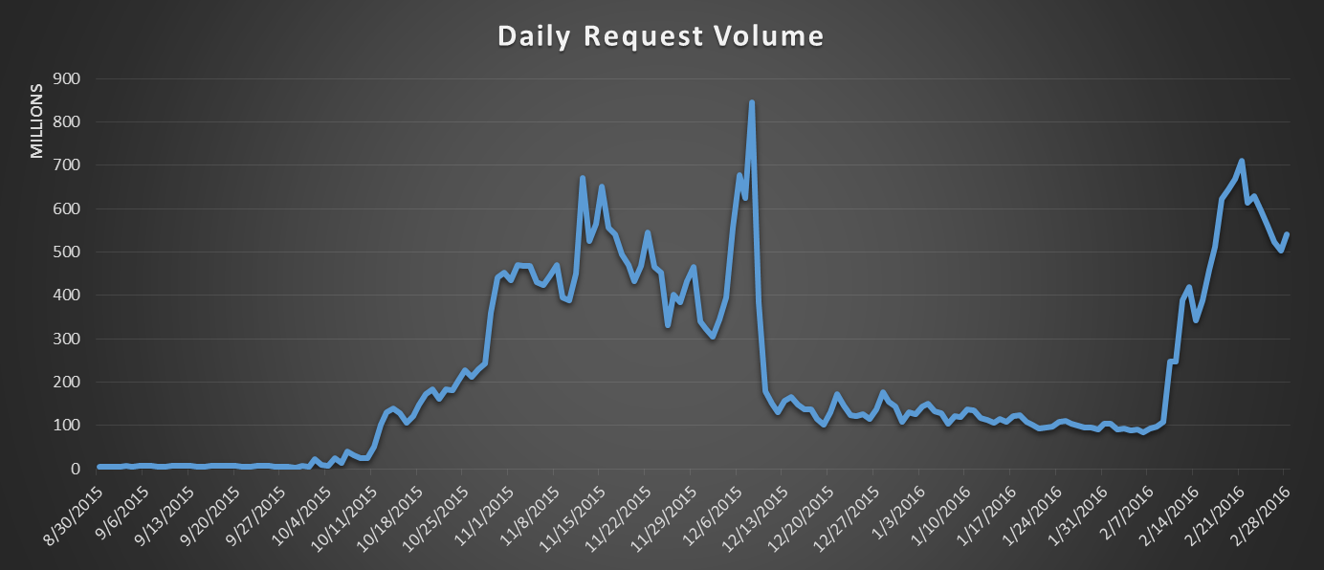
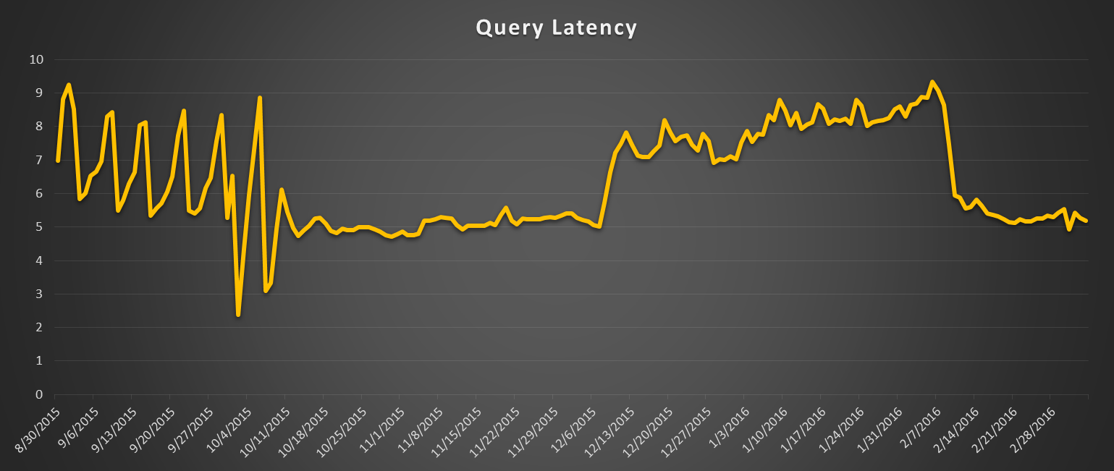
Fear The Walking Dead
#1 in Apple app store free apps during launch week
>1M downloads
~1B queries per day
99% queries served under 10ms
Notes:
All of this sounds like it leaps tall buildings in a single bound… at risk of being overly dramatic, it’s a fantastic product with relatively limited competition, that’s somewhat ahead of its time. It addresses problems of scale and performance that arise with applications managing very large amounts of data… increasingly, this is all applications!

Slide 4
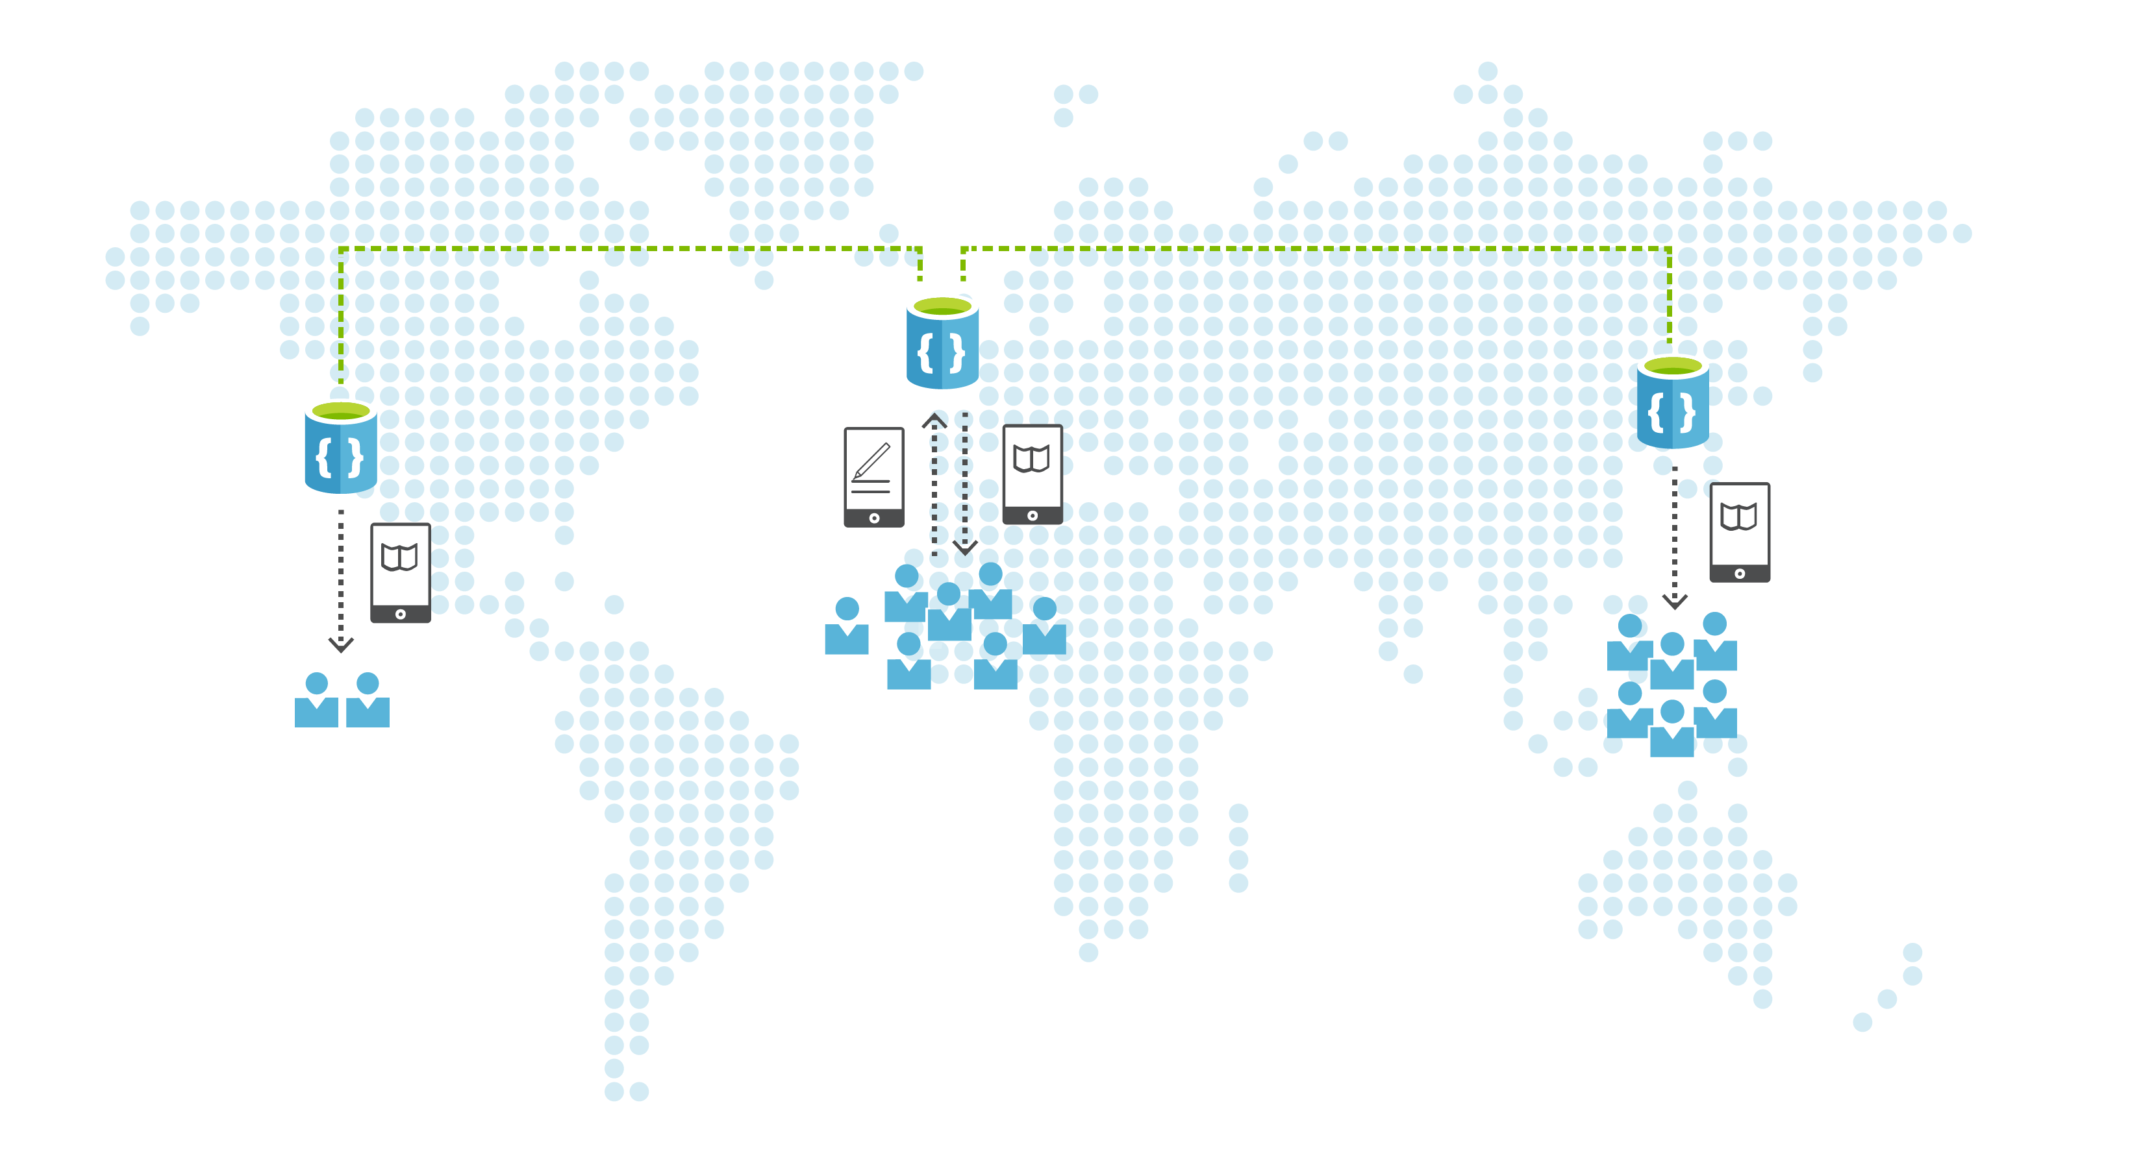
Globally Distributed
Not just for disaster recovery…. DocumentDB is unreasonably highly available
Replicate data across any # of regions of your choice
Low-latency access to your data around the globe
Dynamically configure your write and read regions
Notes:
Available in most Azure data centers now, eventually all

Slide 5

… with well-defined consistency models!
Strong consistency, High latency
Eventual consistency, Low latency
More consistent queries
More performance and availability
Consistency Level | Strong | Bounded Staleness | Session | Eventual
Total global order | Yes | Yes, outside of the “staleness window” | No, partial “session” order | No
Consistent prefix guarantee | Yes | Yes | Yes | Yes
Monotonic reads | Yes | Yes, across regions outside of the staleness window and within a region all the time | Yes, for the given session | No
Monotonic writes | Yes | Yes | Yes | Yes
Read your writes | Yes | Yes (in the write region) | Yes | No
Notes:
Complex slide, lots of data here
On-prem databases (and naïve industry thinking) provide illusion that you can have 100% consistent reads, 100% uptime, and always max performance. In real-world (and in cloud) this illusion gets shattered (see CAP theorem). Many migration failures occur because of this very issue.
Consistency vs. availability is not one-size-fits all. Some applications require every read for X to return latest value, always full stop. Others can tolerate update latencies in exchange for fastest performance.
As DocDB user, you have the control to choose between consistency vs. performance/availability
Go learn about CAP theorem, understand how it will impact your cloud apps. Then look at available options and decide which one best helps you solve that problem.

Slide 6
GEO-REPLICATION

Slide 7
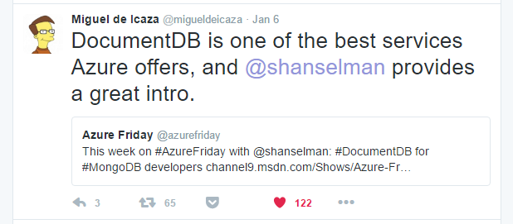
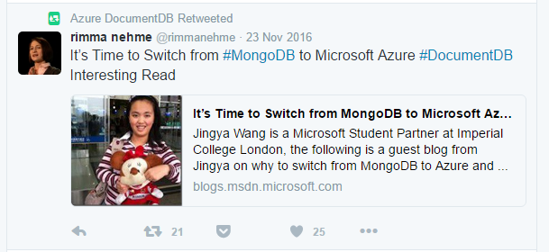
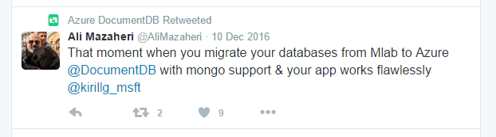
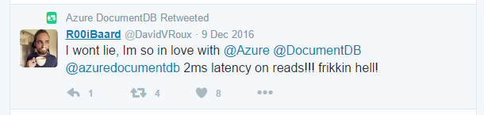
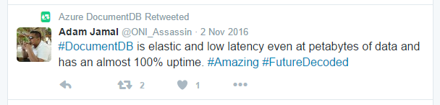

Slide 8

You’re probably not using DocDB…
…most enterprise software still written against relational databases
…variety of NoSQL options out there
MongoDB
Cassandra
RavenDB
CouchDB
Redis
Memcache
Etc.

Slide 9
I have aNOTHER theory…

Slide 10
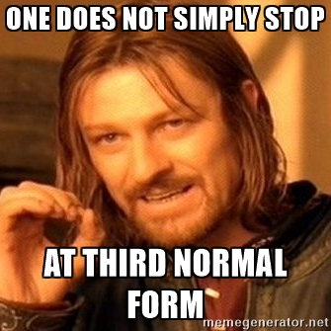
Relational Rob
Often LOTS of tables
Schema-centric and schema-focused
*Not* always data-centric
Application tendencies:
Complex queries
Hard to scale horizontally
Limits to scaling vertically
Tied to ORM
Multi-table joins, locking hints, configurable transaction isolation levels, “user-defined columns”
&*%#$@!($*#$!!?!?

Slide 11
DocumentDB
Relational databases
Document-based
Focus is the data itself
Not a pre-ordained schema
Auto-indexing of all content
(Mostly) transparent data partitioning
Supports configurable, distributed consistency
Row-oriented
Pre-ordained schema is primary
Even to the detriment of accessing applications!
Manual index definitions
Frequent source of perf issues
(Mostly) non-transparent data partitioning
Frequent source of scalability issues
Supports configurable, local consistency

Slide 12

Server-hugger Sam
Many “pets”… no cattle
Focus on IT status quo vs. developer productivity and options
Emotional appeals
“Not secure”
“Not proven”
“Not scalable”
“Something something vendor lock-in”

Slide 13
DocumentDB
Self-hosted database
No server provisioning, configuration or management
Focus is on the data, not the servers
99.99% SLA
<10ms reads and <15ms writes for 99% of queries
Transparent, declarative geo-replication
Failover, regional client reads, etc.
Server provisioning, configuration, and management are all your problem, now and into the future
Enjoy your pets!
“What’s an SLA?”
“Slow queries? That’s a developer problem”
Geo-replication is your problem
…and it’s a BIG problem

Slide 14
App Dev features
.NET and .NET Core, Node.js, Python, Java SDKs… full REST API
Database, collection, and document manipulation, etc.
MongoDB protocol support
Parameterized queries
SQL-based query language
.NET SDK support for LINQ
Server-side Javascript UDFs, stored procedures, and triggers
Multi-document transactions in sprocs and triggers
Local emulator support (yay!)
Query Playground
https://www.documentdb.com/sql/demo

Slide 15

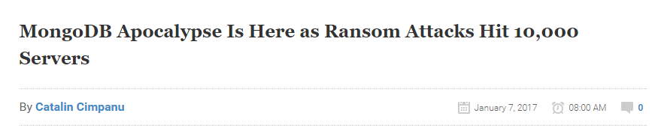
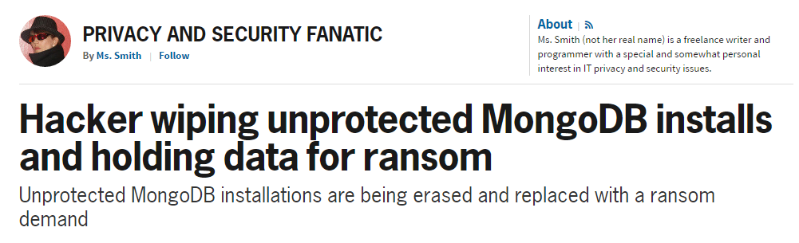
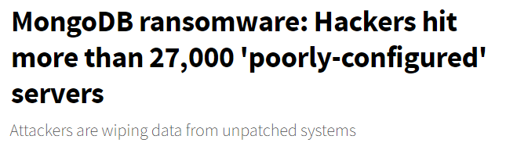

Slide 16
Mongodb protocol support

Slide 17
Pricing
 | Price
SSD-based storage | $0.25/GB/month
Reserved Request Units*/sec | $0.008/100 RUs/hr (~$6/month)
No additional management expense
No additional infrastructure expense
99.99% SLA
10 ms reads, 15 ms writes from anywhere
Geo-redundancy
Auto-indexing
Knobs to configure perf vs. consistency
*a single measure for the resources required to perform various database operations and service an application request… see Estimator Tool https://www.documentdb.com/capacityplanner

Slide 18
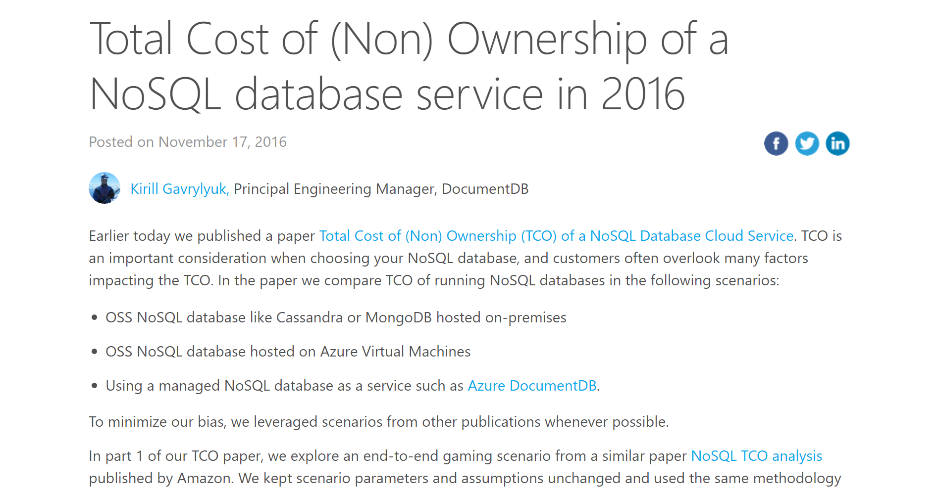
Notes:
https://azure.microsoft.com/en-us/blog/documentdb-total-cost-of-ownership-for-nosql-databases/
https://documentdbportalstorage.blob.core.windows.net/papers/11.17.2016/NoSQL%20TCO%20paper.pdf

Slide 19
Thanks!
Questions?
jlane@wintellect.com
@jplane

